Slide 1
The Latest Buzz with G&C Accounting
Thursday, January 28th, 2021
2:00-3:30PM

Slide 2
Serena Simpson Systems Analyst Lead

Slide 3
Agenda
Topic | Presenter(s)
Welcome | Joshua Rosenberg
Workday Grants Reporting – SABER Overview | Serena Simpson
Workday Basics – Award, Award Line, Grant | Serena Simpson
Workday Grants Reporting – Tips and Tricks, Demo SABER | Serena Simpson
Helpful Reports | Serena Simpson
Commitment Accounting – Salary Reporting, etc. | Terryl Barnes
Award - (Search and View capability, demographics, billing, CIS) | Doug Feller
Grant – (Search and View capability, demographics) | Doug Feller
Warning and Critical Errors | Doug Feller
Prior Year Salary Transfers | Doug Feller
Request Framework | Gabrielle Slappey
Closing PO Obligations | Gabrielle Slappey
Cost Share Progress Report | Gabrielle Slappey
Cost Share Budgets | Glenn Campopiano
Audit – Cost Transfers | Cassandra Belton
Pace Studies | Jonathon Jeffries

Slide 4
Josh Rosenberg Senior Director of Grants & Contracts Accounting

Slide 5
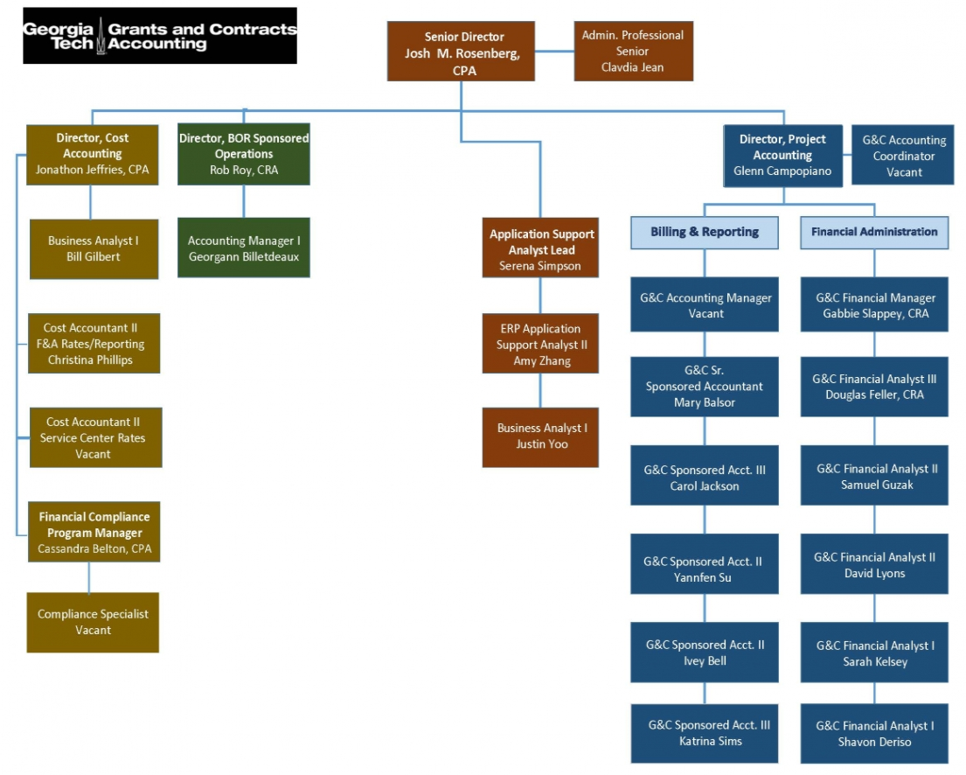
Grants and Contracts Accounting – Who We Are

Slide 6
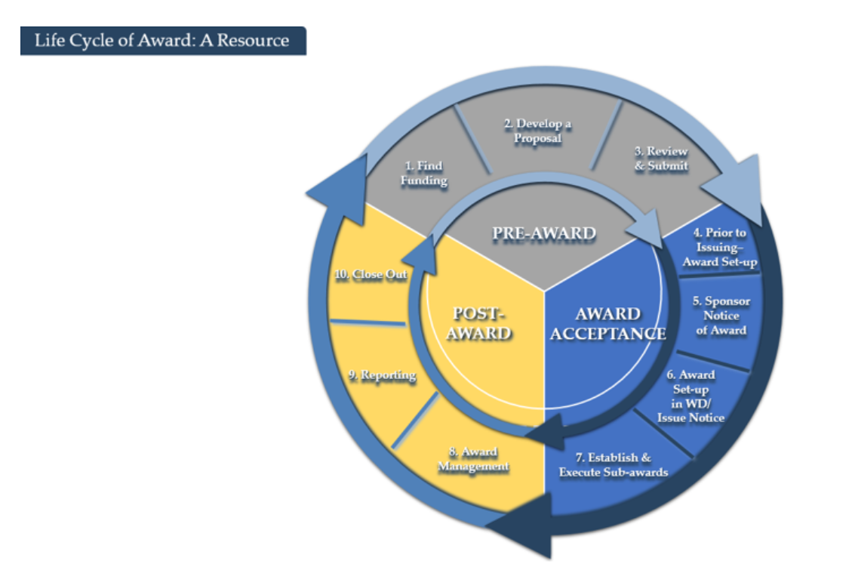
Grants and Contracts Accounting Website
Grants.gatech.edu

Slide 7
Upcoming Research Administration Post-Award Focused Trainings
Class | Date
Post-Award & Compliance (Part 2) | Feb. 2 (Tu)
Post-Award & Compliance (Part 1) | Feb. 4 (Th)
Internal Controls – Workshop | Feb. 11 (Th)
GT Basic Certification – Workshop | Feb. 17 (W)
Subrecipient Monitoring & Reporting | Feb. 23 (Tu)
2 CFR 200 – What’s New | Feb. 24 (W)
2 CFR 200 – Workshop | Mar. 4 (Th)
GT Basic Certification – Workshop | Mar. 11 (Th)
Post-Award & Compliance (Part 2) | Apr. 6 (Tu)
Post-Award & Compliance (Part 1) | Apr. 8 (Th)
GT Basic Certification – Workshop | Apr. 13 (Tu)
Internal Controls – Workshop | Apr. 21 (W)

Slide 8
Workday Grants Reporting
Serena Simpson
Grants and Contracts Accounting, Systems
Systems Analyst Lead

Slide 10
SPONSORED AWARD BUDGET EXPENSE REPORT (SABER)
Type of Reports:
SABER
SABER BY OBJECT CLASS
SABER BY AWARD (NEW)

Slide 11
TIPS AND TRICKS
Question: How do I view actuals for a specific period of time?
Answer: Use the Budgets & Actuals On or After and Budgets & Actuals On or Before criteria

Slide 12
TIPS AND TRICKS
Question: How do I view just the Sponsored portion of my Award, not the cost share (vice versa)?
Answer: Use the Grant Hierarchy field to filter.

Slide 13
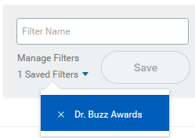
TIPS AND TRICKS
Question: How do I save a filter if I want to view the same criteria on a regular basis?
Answer: Enter Criteria, Create filter name, and Save filter
Question: How do I modify filters?
Answer: You can select Manage Filters and then edit your filter.
Question: Can I create multiple filters?
Answer: Yes, you must create unique filter name. All filters will display in the drop down.

Slide 14
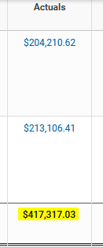
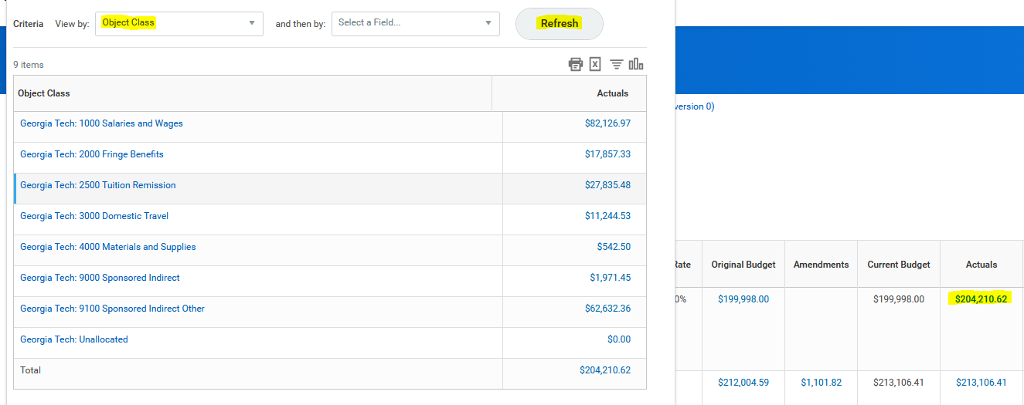
TIPS AND TRICKS
Question: How do I view actual costs by Object Class?
Answer: Drill down on total for Award and/or Grant and view by Object Class and refresh

Slide 15
HELPFUL REPORTS
WORKDAY REPORTS:
SABER
SABER BY OBJECT CLASS
SABER BY AWARD (New)
EXTRACT AWARDS
GT EXTRACT AWARD LINES - GTCR
EXTRACT GRANTS
G&C AD HOC SALARY (LITE)
WORKLET:
Grants Reporting
COMING SOON:
PI DASHBOARD
SABER 2.0v

Slide 16
TIPS AND TRICKS

Slide 17
How can I get help?
Where can
I find help?

Slide 18
Service Now
Security
Someone left the department and needs to be replaced (ex: Grant Manager)
Need a new Grant Manager
Need to add an Assignee
Reporting
Request a change in an existing report
Suggest a new report
Reporting is not working properly

Slide 19
KNOWLEDGE ARTICLES
Search for Knowledge Articles
There are some thirty Knowledge Articles related to Grants and Cost Sharing

Slide 20
Terryl Barnes Commitment Accounting Manager Institute Budget Planning & Administration

Slide 21
Commitment Accounting Reports

Slide 22
Types of Reports
Employee Cost Detail
Monthly Project Cost Detail Report
Ad Hoc Salary Detail Lite
Undesignated Sponsored Justification
Notes:
Below are scripts from a recorded webinar session
So now we will jump into reporting. In OneUSG there are 3 deliberate reports that could be run in PDF format or Excel format, those 3 reports are the Invalid Funding Report, Employee Cost Detail Report and the Monthly Project Detail Report.

Slide 23
Monthly Project Detail Report

Slide 24
Monthly Project Detail Report
Gives a cost report by month for selected worktag for the fiscal year, and includes expended and encumbered salary, fringe, and tuition amounts.
Includes Payroll postings and EDR transactions after final approval.
Project cost detail reports displays all positions/employees whose salaries are allocated to a combo code/worktag.
Notes:
Below are scripts from a recorded webinar session
The Monthly project detail report: This report gives a cost report for each month, actually for the entire fiscal year, it includes payroll postings, encumbrances, and EDR transactions that have been approved at all levels, so the report displays all positions or employees who's salaries are allocated to a particular combo code or work tag, you know if their salaries are placed on that work tag for the entire fiscal year, you should see the salary there for the entire fiscal year or however many months you have it allocated.

Slide 25
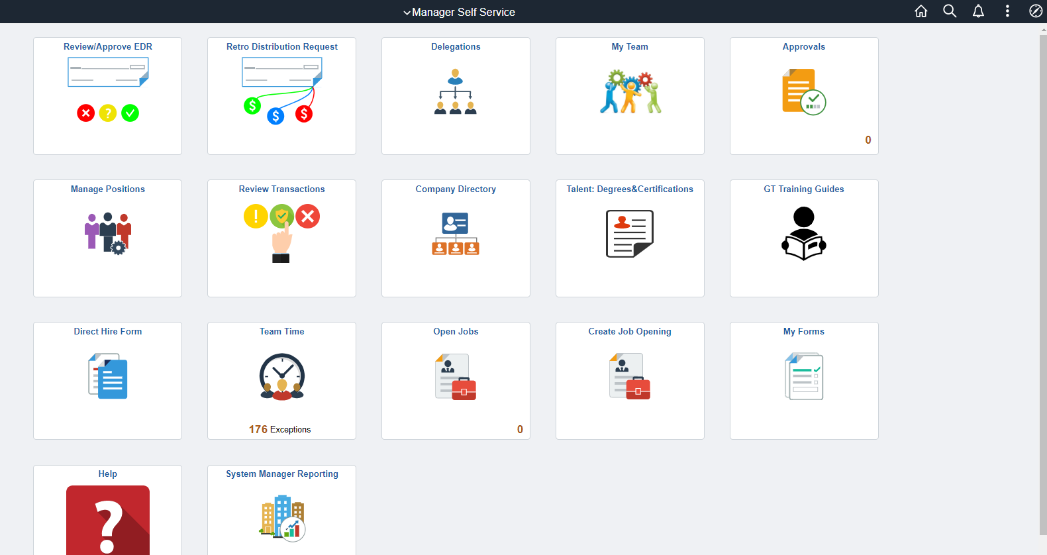
Navigate to Monthly Project Detail
Notes:
Below are scripts from a recorded webinar session
Navigating to the project detail report is very similar to navigating to the invalid funding report. You would click the Employee Self-Service dropdown at the top, select Manager Self-Service, select a System Manager reporting tile.

Slide 26
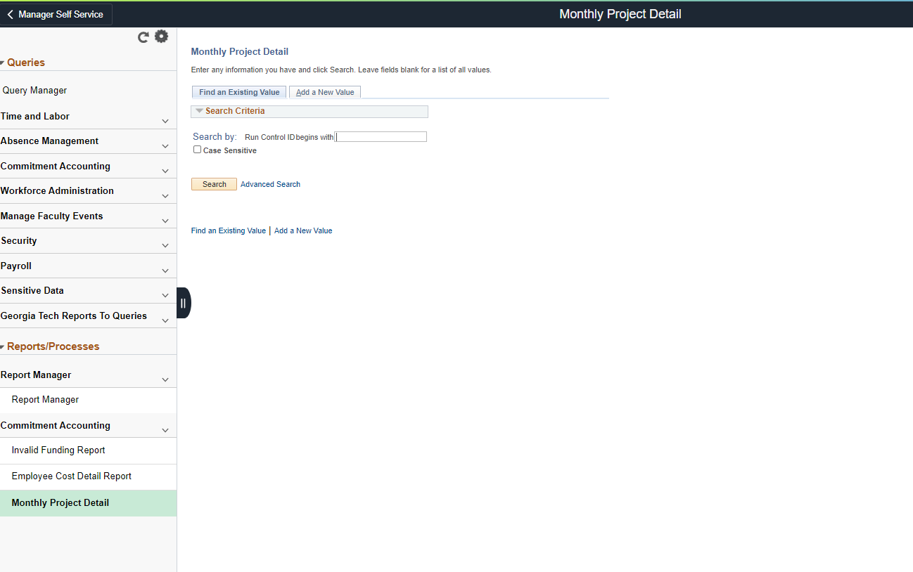
Navigate to Monthly Project Detail
Notes:
Below are scripts from a recorded webinar session
It takes you to the manager reporting work center, you select a monthly project detail link.

Slide 27
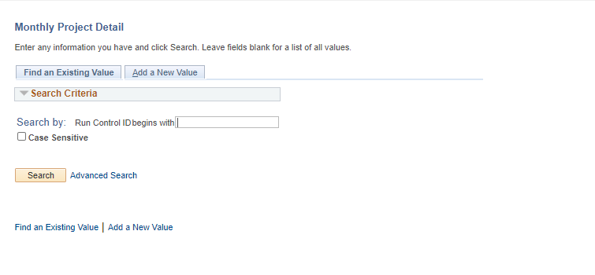
Monthly Project Detail
Select Search or Add a New Value to search for a Run Control ID to run the Monthly Project Detail.
Notes:
Below are scripts from a recorded webinar session
If this is your first time running a new report you would click 'add a new value', it takes you to the run control page once you enter in your run control, I usually use my first initial, last name of my initials, and then I click 'add', it takes you to the monthly project detail report screen for you to enter your parameters.

Slide 28
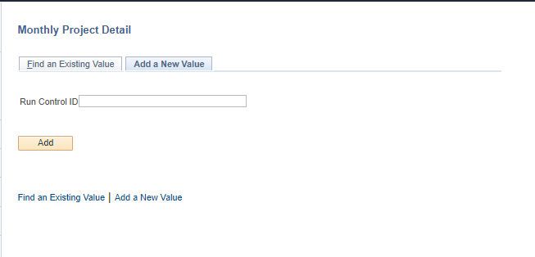
Monthly Project Detail
Populate the Run Control ID field.
To run the monthly project detailed report, use your fist initial and last name as the Run Control ID.
Notes:
Below are scripts from a recorded webinar session
The company again is 030, fiscal year should be 2020, please note that OneUSG will only have current fiscal year data going forward, if you need to run a project detail report for a prior fiscal year that has to be done in the old legacy SPD system.

Slide 29
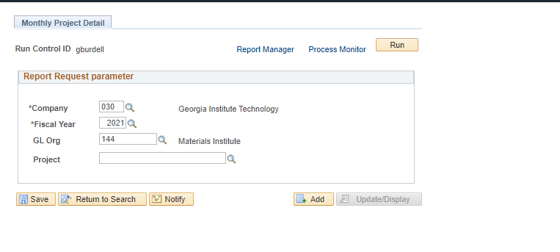
Monthly Project Detail
Populate the details in the Report Request Parameter with the all required fields:
Select Run for a list of available output options
Notes:
Below are scripts from a recorded webinar session
The company again is 030, fiscal year should be 2020, please note that OneUSG will only have current fiscal year data going forward, if you need to run a project detail report for a prior fiscal year that has to be done in the old legacy SPD system. Once you have all your criteria entered, you would click Run, it takes you to the Process Scheduler Requests Screen.

Slide 30
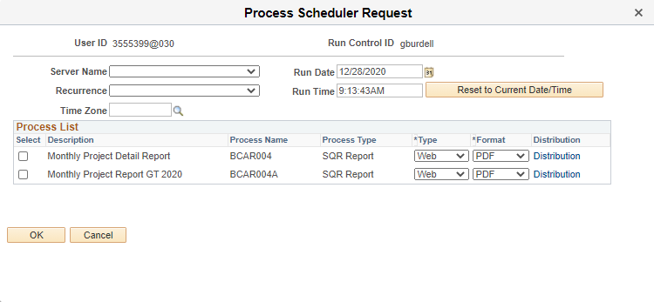
Monthly Project Detail
Notes:
Below are scripts from a recorded webinar session
Check all of your parameters here, if everything is good, you click OK, the report is generated in this processing so in order to view the report you click report manager.

Slide 31
Monthly Project Detail

Slide 32
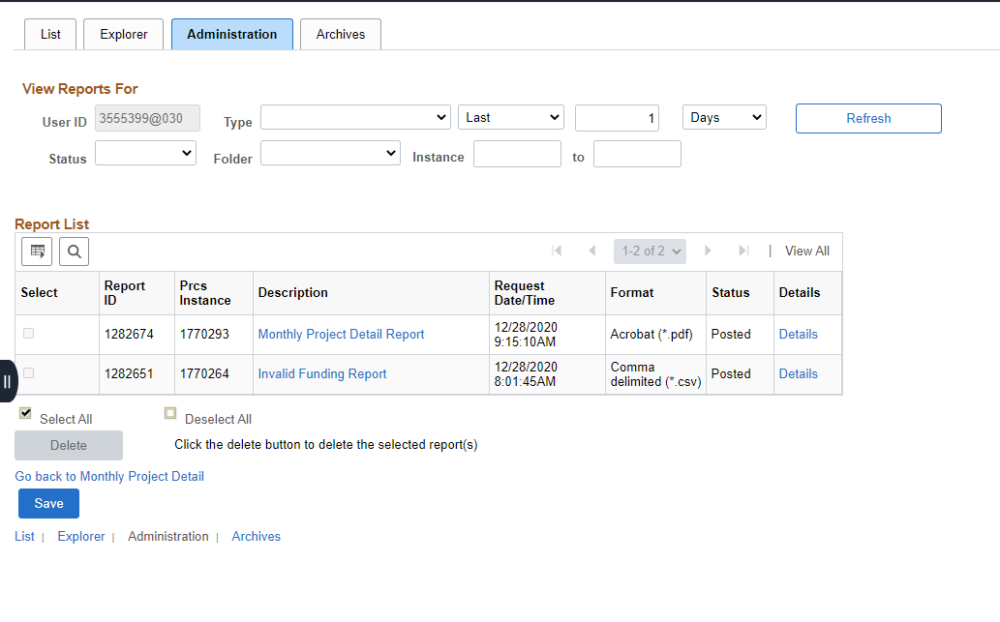
Monthly Project Detail
Notes:
Below are scripts from a recorded webinar session
Click on the administration tab, and then click your monthly project report link and it displays the report based on the format you selected.

Slide 33
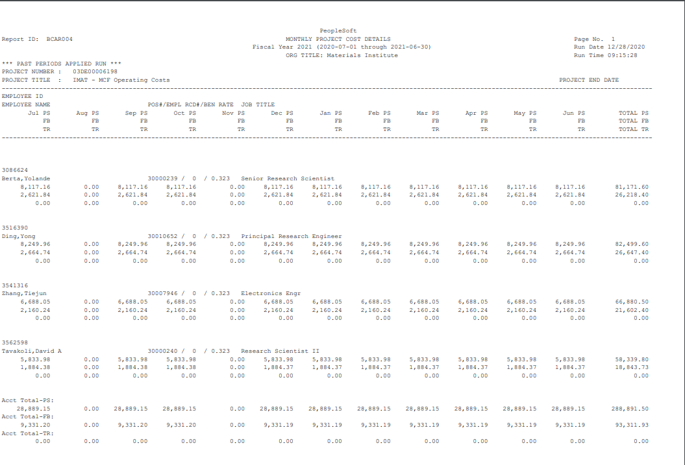
Monthly Project Detail

Slide 34
Demonstration-Monthly Project Detail

Slide 35
Employee Cost Detail Report

Slide 36
Employee Cost Detail
Run by employee's home department
The report can be run for one employee by entering the employee ID# or for multiple employees by leaving the employee ID # blank
Can be run for all paid employees, specific employees, Undergraduate and Graduate employees
The Employee Cost Detail report is required to be attached on all EDRs
Notes:
Reports should be in the System Manager Reporting; CA on left with drop down. You can also get here through the navigator
Below are scripts from a recorded webinar session
The employee costs detail report: this report can be run by GL ORG or department, in OneUSG, there's only one department which is a home department so the GL ORG or the department will be the same in OneUSG, this report can be run for one employee at a time or multiple employees at a time, it can be run for all paid employees, specific employees, graduate students, undergrad students, staff, just depends on your needs for this report.

Slide 37
Navigate to Employee Cost Detail
Notes:
Below are scripts from a recorded webinar session
The navigation is very similar to the previous two reports, navigate to the Manager Self Service page, click the system manager reporting tile.

Slide 38
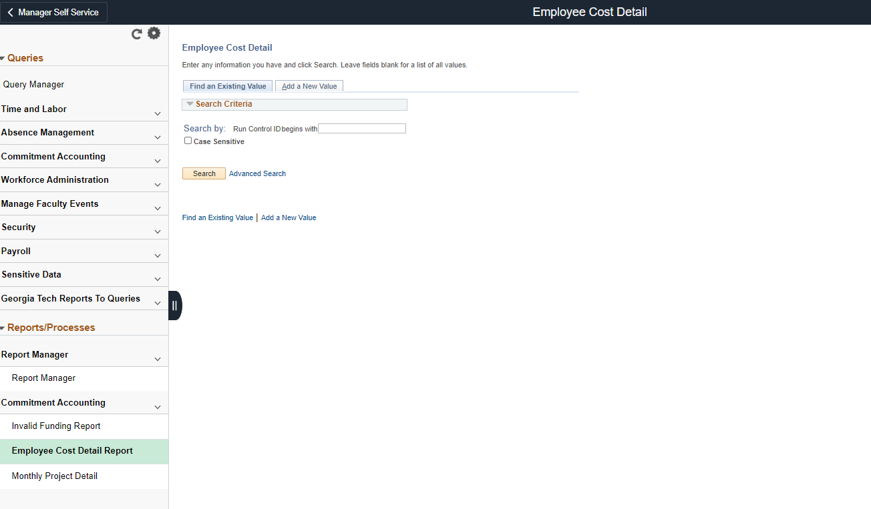
Employee Cost Detail
Notes:
Below are scripts from a recorded webinar session
It takes you to the reporting work center, you select employee cost detail report, by now you should have a run control set up, but if not, you click 'add' to add your run control ID, once you have that, it takes you to the report request parameters page.

Slide 39
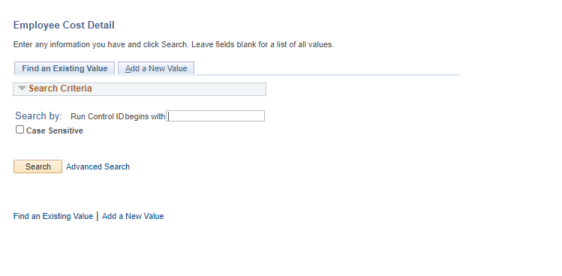
Employee Cost Detail
Select Search or Add a New Value to search for a Run Control ID to run the Employee Cost Detail.

Slide 40
Employee Cost Detail
Populate the Run Control ID field.
To run the monthly project detailed report, use your fist initial and last name as the Run Control ID.

Slide 41
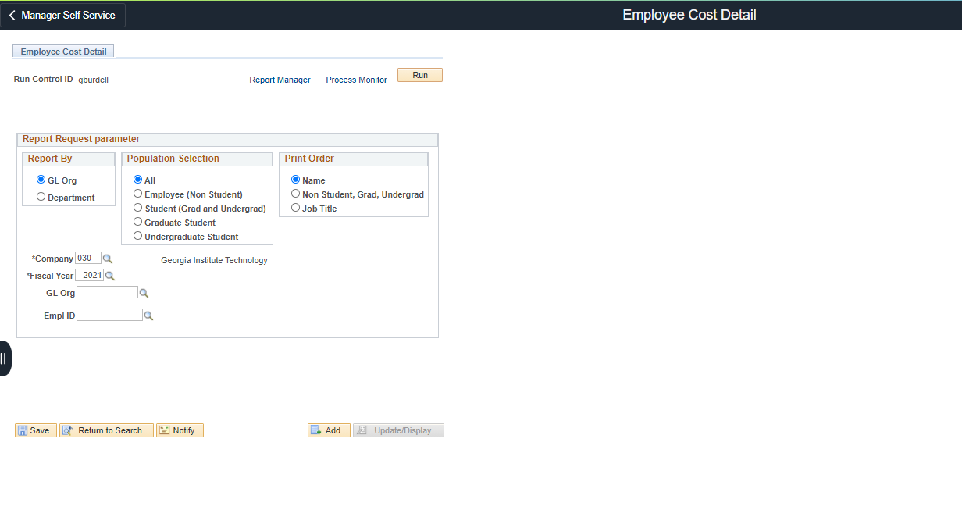
Employee Cost Detail
Notes:
Below are scripts from a recorded webinar session
you can enter your parameters here, where you can select report by GL ORG or department that shouldn't matter, they're both the same. You select your population selection, this is where you would select employees or non-students, grad students, undergrad students, I recommend leaving it set to 'all' and in that way you shouldn't get any errors when trying to run a report, and you could also select the 'print order', I prefer sorting by name but some users prefer sorting by job title, for instance, they want to see all the grad students together and all of their professors together, and then once you have your company, fiscal year, GL Org, employee ID selected, or if you need to run this report for multiple employees you would leave employee ID blank, once you have your parameters selected, you would select 'Run'.

Slide 42
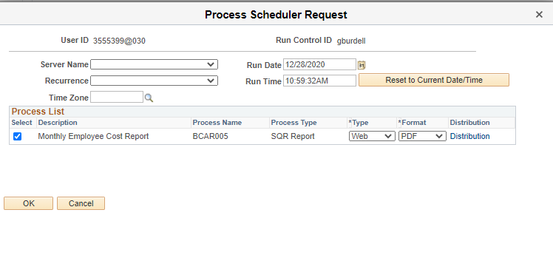
Employee Cost Detail
Notes:
Below are scripts from a recorded webinar session
That brings up the 'process scheduler requests' page, make sure everything is OK here, then you click OK to kick the report off and takes you back to the 'employer cost detail report screen'

Slide 43
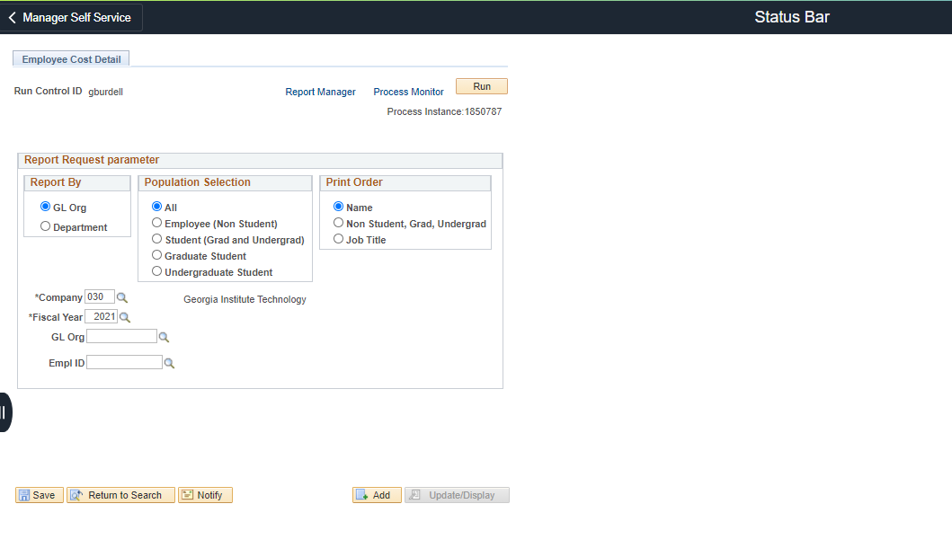
Employee Cost Detail
Notes:
Below are scripts from a recorded webinar session
Select Report manager and it takes you to the status page.

Slide 44
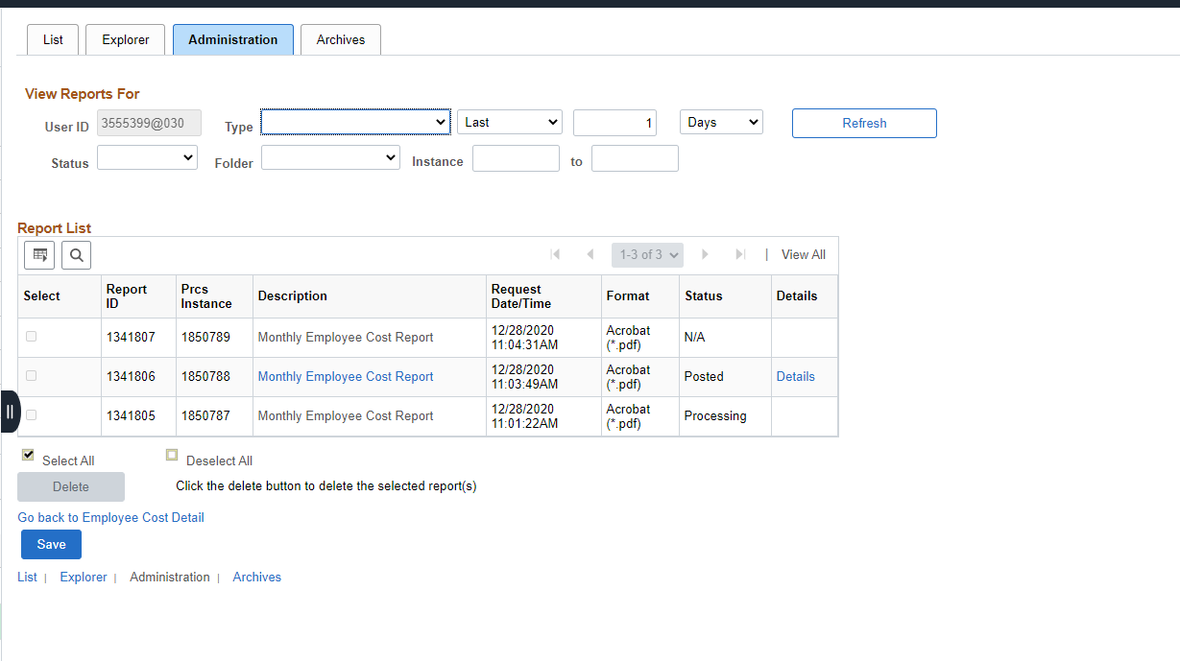
Employee Cost Detail
Notes:
Below are scripts from a recorded webinar session
Select the administration tab.

Slide 45
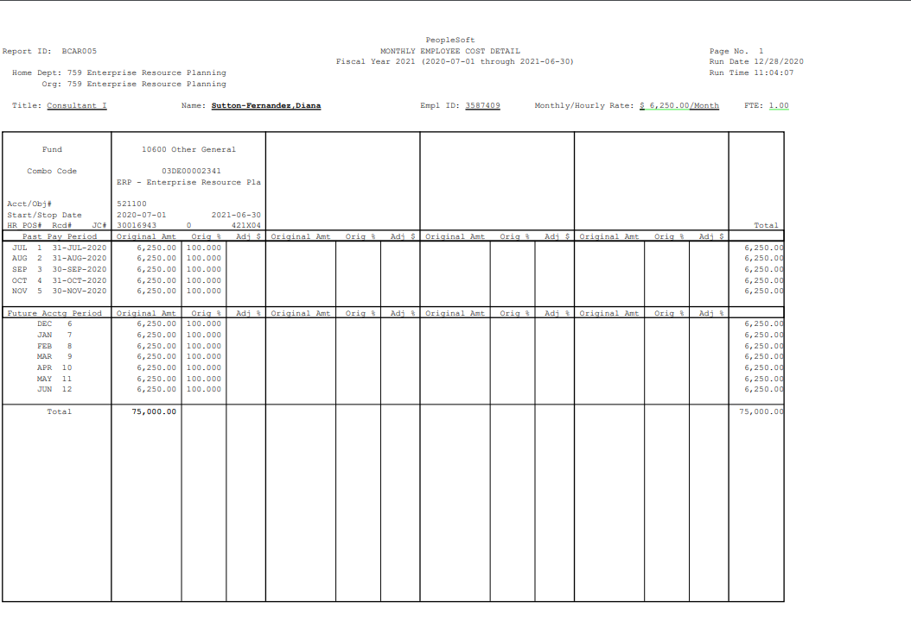
Employee Cost Detail

Slide 46
Demo- Employee Cost Detail Report

Slide 47
Other Reports

Slide 48
Undesignated Sponsored Justification Report
Aged report that displays expenditures and encumbrances allocated to undesignated sponsored work tags
Can be run in summary which shows totals
Can also be run in detail which includes employee information
lite.gatech.edu

Slide 49
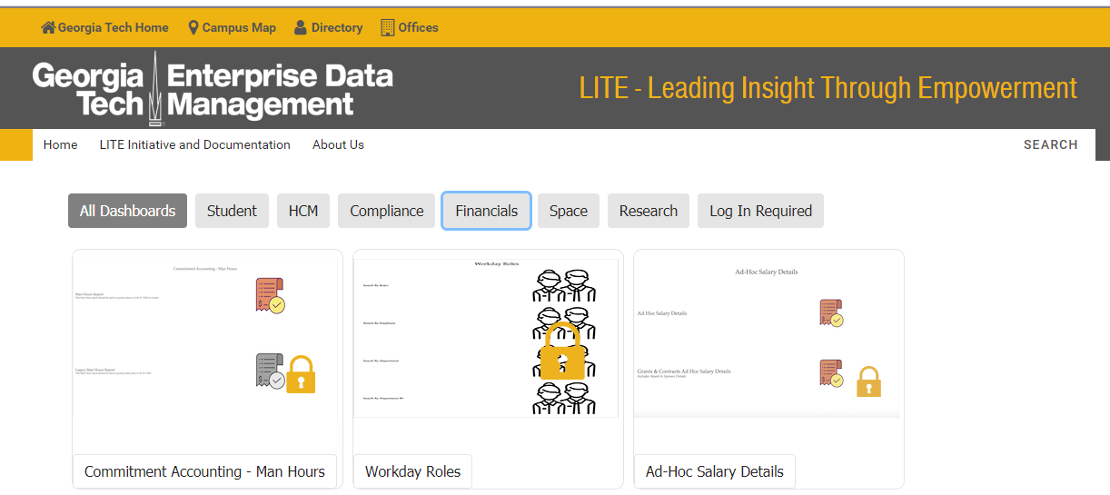
Demo – Undesignated Sponsored Justification

Slide 50
Undesignated Sponsored Justification Report

Slide 51
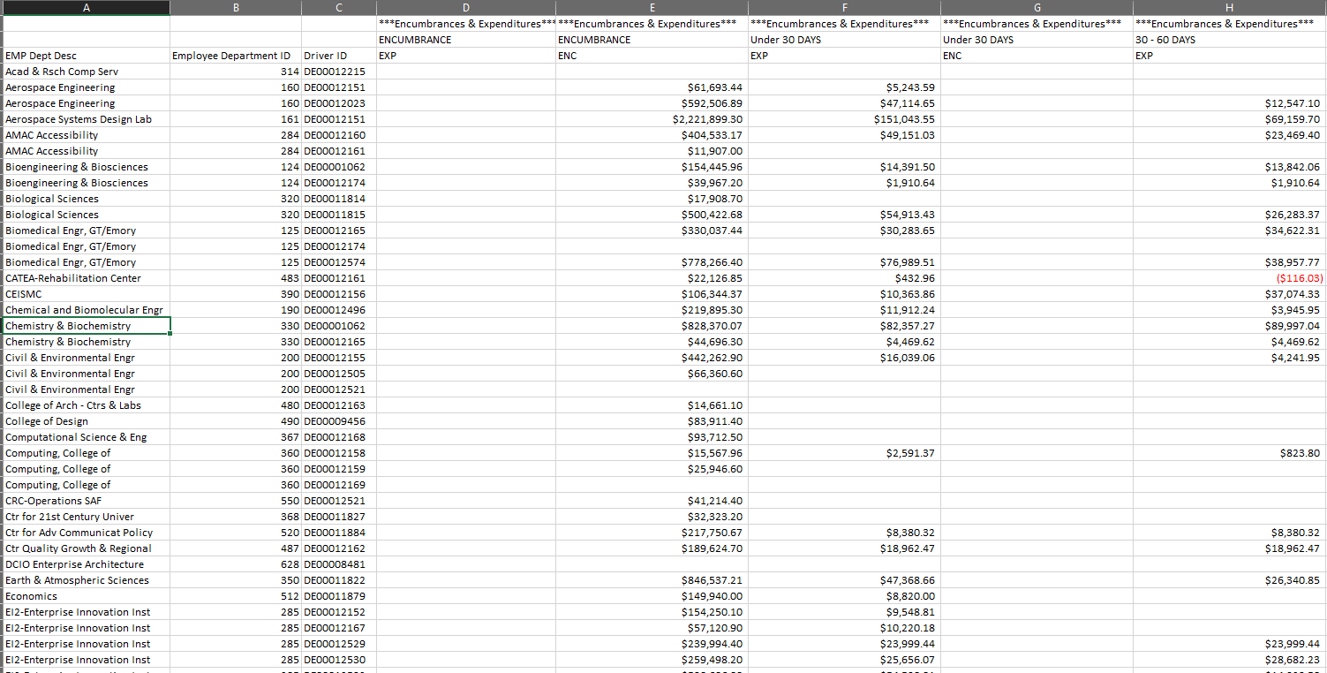
Undesignated Sponsored Justification Report

Slide 52
Ad Hoc Salary Detail Lite Report
Similar to running the USG reports.
Displays salary information by cost center, HR department, worktag, or employee.
Run by journal date or paycheck date.
lite.gatech.edu

Slide 53
Demo – Ad Hoc Salary Details Report

Slide 54
Ad Hoc Salary Details Report

Slide 55
Ad Hoc Salary Detail Lite Report

Slide 56
Doug Feller Project Accounting G&C Financial Analyst III

Slide 57
AWARD – Overview/Summary

Slide 58
AWARD – Overview/Funding Details
Notes:
Overview/Funding Details Page – Shows the Current Funded Amount corresponding with CIS; shown as the Sponsor Total
There is the Anticipated total; that corresponds to the Contract Value in CIS
This award does not have cost share but you can see that there is a category that indicates if cost share is required; Award Total is the summation of Sponsor Total and Cost Share Total
Finally, there is the billed to date total

Slide 59
AWARD – Award Lines Overview
Notes:
Shows the grants associated with the award; their status and the F&A rate;

Slide 60
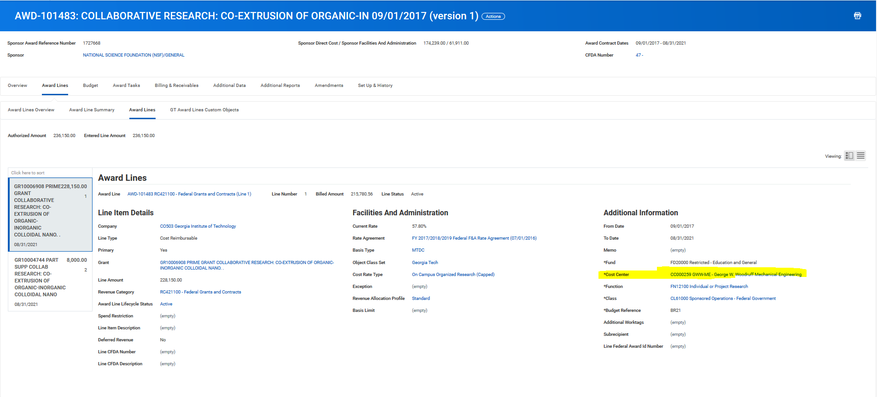
AWARD – Award Lines
Notes:
Has the same information as the Award Lines Overview Tab but it also includes the associated Worktags. Most important being the Cost Center; It also shows the spend restrictions on the award; Toggle between the grants

Slide 61
AWARD – GT Award Lines Custom Objects Class
Notes:
Legacy Project and Fund information

Slide 62
AWARD - Budget
Notes:
All grants with a line item budget are in the budget; if the grant does not have a budget (or expenses/obligations/commitments) it will not show up on SABER;
The total at the bottom of the screen should match CIS funded value and the funding details tab; caveat with Cost Share
Click on the Budget Hyperlink to see admendments

Slide 63
Budget - Amendments
Notes:
AWD-101483 didn’t have amendments so I chose new award; You can see the Amendment Type; description, and the total debits/credits

Slide 64
AWARD –Billing and Receivables
Notes:
All the customer invoices associated with the award; this award is Billed via letter of credit but some awards have CI Adjustment credits; reason will be G&C Sponsor Invoice Reverseal; just for GTRC accounting and G&C; ex. AWD-100844

Slide 65
AWARD – Additional Data
Notes:
Find the Legacy Fund information

Slide 66
AWARD – Additional Reports
Notes:
Additional Reports – Find the Accountant – Questions concerning Billing and Reports
Find the Analyst – All other G&C related questions

Slide 67
GRANT - Details
Notes:
In the grant details you can see what Grant Hierarchy it is under; i.e Federal, Private, State

Slide 68
GRANT – Related Worktags
Notes:
It is important to have the cost center correct; if the cost center is incorrect G&C will need to inactive the grant and create a new grant with the correct cost center. This goes for any worktag but the cost center is the most frequent request.

Slide 69
GRANTS - Roles
Notes:
Find the G&C specialist; 99% is matches the Award Analyst under Additional reports; Grant Manager and Grant PI – you can use the request frame work to change this information.

Slide 70
Prior Year Salary Cost Transfer
Backup Documentation
Cost Transfer Form
Detail about “WHY” the transfer is requested
Detail about “HOW” the transfer benefits the new worktag
All related Spend Categories; i.e Salary, Fringe, and Tuition
Employee Monthly Cost Detail
Revised and Signed ASR
2 Signatures –Employee and Financial Unit Manager
Exception used if Employee has left GT
Additional Information
Notes:
4 essential items needed to send to G&C for a cost transfer; please add relevant information when it come the to “WHY and “How” Reasons
2 signatures needed on the ASR; employee if they are still with GT and the financial unit manager; exemption signature if last resort

Slide 71
Example – Prior Year Cost Transfer

Slide 72
Example – Cost Detail

Slide 73
Example - ASR

Slide 74
Locations for Backup Documents
Cost Detail
NavBar > Navigator > BOR Customization >BOR Commitment Accounting > Monthly Project Detail
ASR
easr.ask@business.gatech.edu
Cost Transfer Form
http://grants.gatech.edu/standard-forms

Slide 75
Reasons G&C declines/sends back Cost Transfer
Decline
Over 90 days
Expenses are on a State account
“To” grant is already over budget
Spend Back
Lack of Backup Docs
Lack of Signatures
Weak Explanation on the Cost Detail
Lacks Grant Worktags
DE to DE
GTF to DE
Notes:
Caveat with over 90 days includes late setup by G&C and/or OSP; we cannot move prior year expense from State account; Cost transfers without a Grant Worktag should go to the controller’s office.

Slide 76
Gabrielle Slappey Project Accounting G&C Financial Manager

Slide 77
Request Framework – Create New Request
Using Create Request allows
Grant attribute changes - grant name, grant status, grant manager
New award line/grant request
GTRI Interdivisional grant request
Request cash transfers typically related to memberships
Maintains a trail of requests in WD
Grant Managers
For Grant Managers that are leaving the institute, please be sure to complete a Service Now ticket before departure
Mass changes use Service Now
One offs (or a handful), use Create Request

Slide 78
Request Framework – New Award Line/Grant
Add detailed description of the request
“This is a Subaward request for the University of Georgia.”
General Comments is also useful for this
Choose the correct Purpose
Subawards – External (i.e. University of Georgia)
Internal Collaboration – Internal (i.e. COPI)
Important to specify the correct Cost Center for new grant line
New grant will need to be created if incorrect
Use the Award number
Not the Prime Grant
Notes:
Make sure the request has as much information as possible; cuts down the emails needed to figure out the request; be aware the subawards is for external entities; make sure you add the correct cost center, G&C will have to create a new award if it needs to be changed; use the award number not the prime grant, we look the information up in CIS.
General comments is a good place to specify the new PI name, subawardee, spend restrictions for the grant, different F&A from Prime, etc

Slide 79
Closing PO Obligations
Change Order Requisition/Service Now
G&C Analysts typically reach out to departments to initiate the review and action on open obligations
Departments should work with Procurement to close obligations
If subaward is involved, there may need to be coordination and discussion w/OSP Subaward team

Slide 80
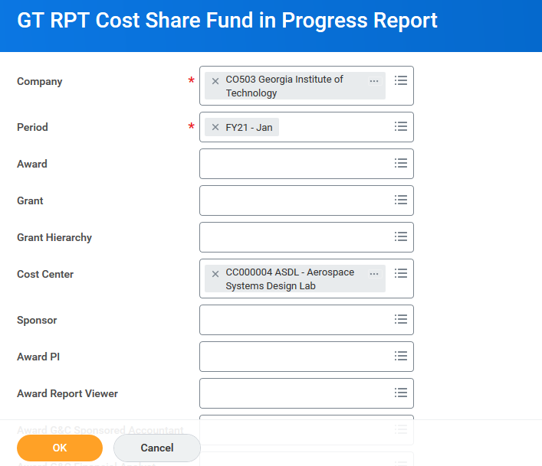
Cost Share Progress Report
Similar to legacy Cost Share Progress Report
Provides a snapshot of all cost share requirements
Provides a comparison of both sponsored portion and cost share portion
Drillable links that provide further expense detail

Slide 81
Glenn Campopiano Project Accounting Director of Project Accounting
Project Accounting Topics

Slide 82
WORKDAY COST SHARE BUDGETS
G&C Process for Loading Cost Share Budgets

Slide 83
Grants & Contracts Accounting (G&C) is revising the Workday (WD) budget process for state-funded Cost Share (CS) Grant Lines based on the submitted CS budgets in the Office of Sponsored Programs’ Contract Information System (CIS).
G&C will no longer upload budgets from OneBudget to update cost share budgets in WD. The revised G&C process for creating cost share grant lines and budgets in Workday is as follows:

Slide 84
1. When a new award is established in WD with a cost share requirement, the cost share budget in CIS will be used to populate the grant line budgets. Award modifications related to CS will be treated similarly.
2. The unit may choose to transfer state budget direct dollars to the cost share work tag in OneBudget. This does not affect WD Grants; it only revises the unit’s state budget allocations across worktags and helps keep track of their state funds used to meet cost share.
3. Revisions to cost share budgets in WD will be handled by the unit. The process is the same as revising budgets of sponsored awards in WD.
4. If multiple cost share grant lines are desired by a unit (for example, sub awards having a cost share requirement), the unit will request a new award line and then once the Grant worktag is established, perform the required budget transfer from the main to new grant line.
5. G&C will focus on expenses in cost share grant lines to ensure the unit is on track for meeting cost share and for reporting to sponsors. The unit is responsible for posting adequate, timely expenses to meet cost share.
6. Units are encouraged to adhere to the budget plan submitted to OSP, as it has been approved internally and accepted by OSP.
7. There should NEVER be budget revisions from Sponsor budget lines to CS budget lines or vice versa. Revisions to CS budgets in WD should rarely be needed, except as noted above.

Slide 85
Cost share budgets in WD do not reflect actual funding – the funding is only done through OneBudget like any other state dollar funded worktag. The budgets in WD will help units identify remaining cost share required as expenses post in WD and a CS balance is shown relative to the proposed CS budget.

Slide 86
Cassandra Belton Cost Accounting Financial Compliance Program Manager

Slide 87
Audit Climate & Cost Transfers > 90 Days Compliance
Audits on the rise in 2020
6 Sponsor site visits
20+ Sub-recipient certifications
Focus on internal controls:
Policies in place & followed
Adequate review and approval
Sufficient documentation
Terms & Conditions Compliance
Timely corrections and close-outs
Cost Transfers > 90 Days
Acceptable Justifications
Delayed award execution
Specific approval from receiving sponsor
New award to meet sponsor need where core contract, PI, & SOW are unchanged
Transfer of allowable costs to a fixed price award
90 day count determined once complete submission received
Attachments for Journals and Adjustments > 90 days
Notes:
Caveat with over 90 days includes late setup by G&C and/or OSP; we cannot move prior year expense from State account; Cost transfers without a Grant Worktag should go to the controller’s office.

Slide 88
Jonathon Jeffries Cost Accounting Director of Cost Accounting

Slide 89
High Performance Computing (HPC) Cost Model https://pace.gatech.edu/update-gts-research-cyberinfrastructure-cost-model
Goal: A more sustainable and flexible way to support research cyberinfrastructure
Team: EVPR, OIT (PACE), EVP-A&F, and GTRC
Who is affected:
Researchers who leverage PACE services
Grants and Contracts administrators
OSP staff
…

Slide 90
HPC Cost Model https://pace.gatech.edu/update-gts-research-cyberinfrastructure-cost-model
What is changing:
Major research cyberinfrastructure (including compute and storage services) will be treated like other core facilities.
PACE transitions from a service that purchases hardware with equipment funds, to a service which operates as a Cost Center. An approved rate study has been completed.

Slide 91
HPC Cost Model https://pace.gatech.edu/update-gts-research-cyberinfrastructure-cost-model
When will it happen:
Plan was approved in December 2020
The new model coincides with the transition from old equipment in the Rich building to new equipment in the CODA data center
No billing will occur until at least March 2021
PACE is committed to collecting data and feedback regularly and will review the model annually to allow for continuous improvement.

Slide 92
HPC Cost Model https://pace.gatech.edu/update-gts-research-cyberinfrastructure-cost-model
How it looks to the PIs:
In place of specific compute nodes, PIs will receive a corresponding number of credits which can be drawn down over the course of a project.
Existing equipment in PACE (Rich Building) converted to an equivalent # of credits available for at least 5 years.
The cost of the credits (CPU hours, GPU hours, etc.) is determined by the equivalent cost of the hardware assuming 24/7/353* use for 5 years (*excludes scheduled maintenance).

Slide 93
HPC Cost Model https://pace.gatech.edu/update-gts-research-cyberinfrastructure-cost-model
Benefits to researchers:
Researchers will only pay for actual consumption – similar to commercial cloud offerings from AWS, Azure, and GCP.
Researchers have more flexibility to leverage new hardware releases instead of being restricted to hardware purchased at a specific point in time.
PACE team uses capacity/usage planning to make compute cycles available to faculty in days or weeks as opposed to waiting for months due to procurement bottlenecks.
A free tier that provides any PI the equivalent of 10,000 CPU-hours on a 192GB compute node and 1 TB of project storage at no cost every month.

Slide 94
HPC Cost Model https://pace.gatech.edu/update-gts-research-cyberinfrastructure-cost-model
Other important points:
We have secured an Indirect Cost Waiver on both PACE services and commercial cloud offerings for at least two years to allow us to collect data on the model and see how it is working.
Similar consumption models have been used successfully at other institutions such as Univ. Washington and UCSD, and this approach is also being developed by key sponsors (e.g. NSF’s cloudbank.org).

Slide 95
HPC Cost Model https://pace.gatech.edu/update-gts-research-cyberinfrastructure-cost-model
Other important points:
RI only, not GTRI (unless they use PACE)
This model will also apply to startup funds and matches (ie funded with dollars but PI’s will see credits)
PACE will invoice projects monthly with usage (both compute and storage).
Storage can be purchased in advance, but compute is paid for after it is consumed.
A few projects “in flight” may need engagement with program directors
Standard proposal language being developed

Slide 96
HPC Cost Model https://pace.gatech.edu/update-gts-research-cyberinfrastructure-cost-model
Other important points:
There will be a distinct ledger account number for PACE in Workday. PACE also plans to use a distinct journal source.
Also, distinct account for commercial cloud computing
These accounts will have the F&A waiver, but can only be used for approved services

Slide 97
Workday – HPC New Ledger Accounts
714128 (SC714128) – Cloud Computing Internal (PACE)
Internal Account will be used by PACE for Internal billing only
714129 (SC714129) – Cloud Computing External
External Account for the purchase of commercial Cloud services such as research storage, managed services, and cloud services through direct contracts with Amazon AWS, Microsoft Azure, and similar vendors.

Slide 98
Proposal Budget – Initial Details
Proposal budget from unit/PI includes a line for HPC/cloud computing in direct costs which will be excluded from the F&A calculation in the same manner as tuition, equipment and other direct costs are not subject to F&A.
Most sponsor budget forms include an “other direct cost” (not to be confused with Workday ODC) and HPC could be accounted for in this category.
Please communicate EARLY with your CO, but definitely meeting the GT policy of 3-day submission prior to official sponsor deadline.
Cost will be placed on Line #11 in CIS (called Other) along with a comment that it is not burdened with F&A.
When budget comes to GCA, it will be included in the Workday budget as the HPC object class.

Slide 99
Proposal Budget – IMPORTANT NOTE
More details on how to handle these expenses in your proposal submission and how they will be processed in eRouting will follow ASAP via an announcement in the RAB email listserv and on the GT Research Administrators Network team.
Until then:
Please communicate EARLY with your CO that you have included these charges in the proposal so they can help you determine the best way to reflect them in the specific sponsor's budget.
If already submitted in the proposal and awarded, work with your GAC Financial Analyst regarding how it is reflected in Workday.

Slide 100
The Latest Buzz with G&C Accounting
GRANTS.GATECH.EDU

Slide 101
GRANTS.GATECH.EDU

