Slide 1
Presenters: Christina Phillips - Grants
Svetlana Soroka - CPSM
Jimmie Hardin - CPSM
Sponsors: James Fortner Sandra Mason

Slide 2
Housekeeping
Attendance​
This Webinar is a lecture-style offering.​
Your microphone has been muted upon your entry to the training.​
Please drop your questions in the group chat via WebEx.​​

Slide 3
Safe Harbor
The information delivered within this presentation was originally published in April 2020.
This information, while accurate at the time, is subject to change.

Slide 4
What is the Space Survey?
1) Process of functionalizing assignable square footage in accordance with 2 CFR Part 200 classifications
2) To ensure Federal Tax code compliance for non-qualifying Tax-Exempt purposes

Slide 5
Why a Space Survey?
Documentation in support of F&A proposal
FY20 is the base year for the FY22 F&A rate proposal to the Office of Naval Research (ONR)
Identify research performed in buildings
Scientific research performed in tax exempt bond financed buildings must meet IRS requirements for Safe Harbors

Slide 6
Timeline
Space Survey Training April 22 & 23
Departments Complete Survey July 31
Quality Review by CPSM and G&C August 31
Surveyor Corrections Due September 30
Certifications Due October 30
F&A Proposal Due December 31

Slide 7
Space Survey Tool Kit
Access to
Floor Plans
Functional Definitions
Training with INSITE
Personal Knowledge
FY20 Space Survey
Grants List - Excel
Employee List
Financial Managers

Slide 8
Data Review
Room Demographics - room number, square footage
Use Code - room use should be confirmed or modified as appropriate
Station Count – Number of workstations in labs and offices, or
number of seats in classrooms, conference rooms and meeting rooms
appropriate number of occupant that can occupy a space
Occupants - employee names required for all faculty, professional staff, and Post-Doc offices
Principal Investigator - PD/PI employee name required for all lab, lab service, and grad offices
Function - required for all labs and lab service areas
Grant – required for all labs, lab services, and similar space with any space functionalized as Organized Research

Slide 9
Functional Definitions
OR - Organized Research
IDR - Instruction & Departmental Research
OSA - Other Sponsored Activities
OIA - Other Institutional Activities
OTH - All Other (Vacant)
Primary GIT Functions

Slide 10
Organized Research (OR)
Sponsored Research – Externally funded and
separately budgeted research and development projects; including research training
University Research – Internally funded and separately budgeted research and development projects
- “Committed” Cost Sharing Projects – Funded from
GTF, GTRC, State (non-sponsored) funds
- Other projects derived from similar sources through a
competitive application and award process

Slide 11
Instruction / Departmental Research (IDR)
Instruction – Standard Teaching and Training activities
Departmental Research - Internally funded General Research
- New Faculty Start-Up Funds
- GTF projects (research gifts) not used as cost-share
- Other projects derived from internal sources provided
on a non-competitive basis

Slide 12
Other Sponsored Activities (OSA)
Externally funded projects for activities other than instruction and
organized research.
This includes sponsored public service projects and community
service programs that provide non-instructional services to
external individuals or groups.
    EII Field Offices, other economic development activities
    Conferences, institutes, general advisory services,
    reference bureaus, radio and television
    - Consulting and similar non-instructional services to
particular sectors of the community
If undertaken by the Institute without outside support, then OIA

Slide 13
Other Institutional Activities (OIA)
All activities EXCEPT for:
1) Organized Research,
2) Instruction & Departmental Research,
3) Other Sponsored Activities
4) all facilities & administrative (indirect) support functions:
(building/equipment maintenance, libraries, and general/departmental
administration)
OIA includes:
- Auxiliary Services
- Service/Cost Centers
- Space used by external entities

Slide 14
Required Data
Room Use | Req’d Occupant / PI | Req’d Function | Req’d Grant | Req’d Station Count
Research/Open Lab & Service | PI Name | Function %s | Grant(s)-OR | Workstation Count
Class Lab | N/A | N/A | N/A | Workstation Count
Acad / Non-Acad Office | Occupant Name | N/A | N/A | Workstation Count
Post Doc Office | Occupant Name | N/A | N/A | Workstation Count
Grad Office | PI Name | N/A | N/A | Workstation Count
Conference / Meeting Rooms | N/A | N/A | N/A | Seat Count
Classrooms / Lecture Halls | N/A | N/A | N/A | Seat Count
Room Use Req’d Info-1 Req’d Info-2 Req’d Info-3
Research/Open Lab & PI Name Function %’s Grant(s) -OR
associated service spaces
Academic/Non-
Academic Office Occupant Name N/A N/A
Post Doc Office Occupant Name N/A N/A
GRA Office PI Name N/A N/A
Conference Rooms/
Common Areas N/A N/A N/A
Classrooms/
Lecture Halls N/A N/A N/A

Slide 15
Example 1:
Professor George Burdell has an office in one of your assigned buildings.
How should this room be coded on your survey list?

Slide 16
Example 1:
Professor George Burdell has an office in one of your assigned buildings.
How should this room be coded on your survey list ?
* Use Info: Confirm “ACADOF Academic Office”
* Function Info: N/A
* Occupant Info: Burdell,George P (from menu)
* Grant Info: N/A

Slide 17
Example 2:
Professor Burdell’s research lab is used as follows:
75% for NIH research grants,
15% for general research supported by GTF (gift) funds
10% for research “cost-sharing” supported by GTRC.
How should this room be coded in INSITE?

Slide 18
Example 2:
Professor Burdell’s research lab is used as follows:
75% for NIH research grants,
15% for general research supported by GTF (gift) funds
10% for research “cost-sharing” supported by GTRC.
How should this room be coded in INSITE?
* Use Info: Confirm “RSLBDRY-Research Lab Dry”
* Function Info: 85% OR 15% IDR
* PI Info: Burdell, George P.
* Grant(s) Info: GR10000057 - assigned to Burdell,George P.

Slide 19
Example 3:
Room B76A, previously a “Graduate Student Office”, is now occupied by the Department’s Financial Manager, Sandra Wilson.
How should this room be coded in INSITE?

Slide 20
Example 3:
Room B76A, previously a “Graduate Student Office”, is now occupied by the Department’s Financial Manager, Sandra Wilson.
How should this room be coded in INSITE?
* Use Info: Update to “NACDOF Non-Academic Office”
* Function Info: N/A
* Occupant Info: Wilson, Sandra - 3521906 (from menu)
* PI Info: N/A
* Grant Info: N/A

Slide 21
Example 4:
Room 214 “Research Lab” is a Dry Research lab currently under renovation but is serviced by utilities & HVAC.
How should this room be coded in INSITE?

Slide 22
Example 4:
Room 214 “Research Lab” is a Dry Research lab currently under renovation but is serviced by utilities & HVAC.
How should this room be coded in INSITE?
* Use Code: Confirm “RSLBDRY-Research Lab Dry”
* Room Comments: “Vacant Space Under Renov - Service”
* Function Code: “OTH” (100%)
* PI Info: PI, Unspecified
* Grant: N/A

Slide 23
Example 5:
Room B76F is a microscopy core lab used for general research.
How should this room be coded in INSITE?

Slide 24
Example 5:
Room B76F is a microscopy core lab used for general research.
How should this room be coded in INSITE?
* Use Code: Confirm “RSLBDRY-Research Lab Dry”
* Function Code: “IDR” (100%)
* PI Info: PI, Core Lab
* Grant Info: N/A

Slide 25

Review Points:
Office Space
  Confirm and/or Update Use Code
  Select Occupant Name for Faculty, Staff, and Post-Doc offices - REQUIRED
  Occupant names are not required for Graduate Student Offices, but PI is required
  Function Codes are not required
  Grant(s) are not required

Slide 26

Review Points (Cont’d.):
Lab and Lab Service Space
  Confirm all Use Codes to new designations
  Select PI Name(s) - REQUIRED
  Enter functions and percentages for activities performed in the room – REQUIRED
  Select Grant(s) activity performed in the room. REQUIRED for OR
  Lab service space supporting a specific lab should be coded to match the applicable lab (PI names, functions, and grants)

Slide 27

Review Points (Cont’d.):
Conference Rooms and Other “Common” Space
  Confirm and/or Update Use Code
  No additional information is required IF used/open for ALL departmental activities

Slide 28

Review Points (Cont’d.):
Vacant Space
  Lab Space – Use Code based on primary FY activities or as “OTH”
  Office Space –If an office is unoccupied, use ‘VACANT, OCCUPANT’ in person list for occupant.
  Use Room Comments Field to indicate…..
  Transitional Space
  Employee Name not listed (enter name)
  Under Renovation (indicate if serviced by utilities, HVAC)

Slide 29
Issues:
Coding 100% Organized Research in all research labs
Functions of non lab space
Use Room Comments Field when possible
Co-PIs – Grants List
Vacant Space
- Labs – May be functionalized based on the activities performed during the period of use if utilized during the majority of the fiscal year.
- Offices – If an office is unoccupied, use ‘VACANT, OCCUPANT’ in person list for occupant. Use Comments Field to enter additional comments as needed.
Professional judgment is the key – Consult with Unit Financial Officer
Space Survey requires Certification and subject to Audit

Slide 30
INSITE Space Survey Module
Very similar to last survey:
  Station count required for certain use codes
  If an office is unoccupied, use ‘VACANT, OCCUPANT’ in person list for occupant
  PIs required for all grad student office and research lab use codes (use “PI, UNSPECIFIED” if PI is not in person list)
  Use special “PI, FOR CORE LABS” in person list to indicate PI for Core labs
No login required – but you must use the GT VPN for remote access. For campus access, your computer’s IP address must be in the access list.
You will receive an email with your survey link – You may forward this to others who will assist you with the survey.
The following slides can be used as a reference while you are filling out your survey.

Slide 31
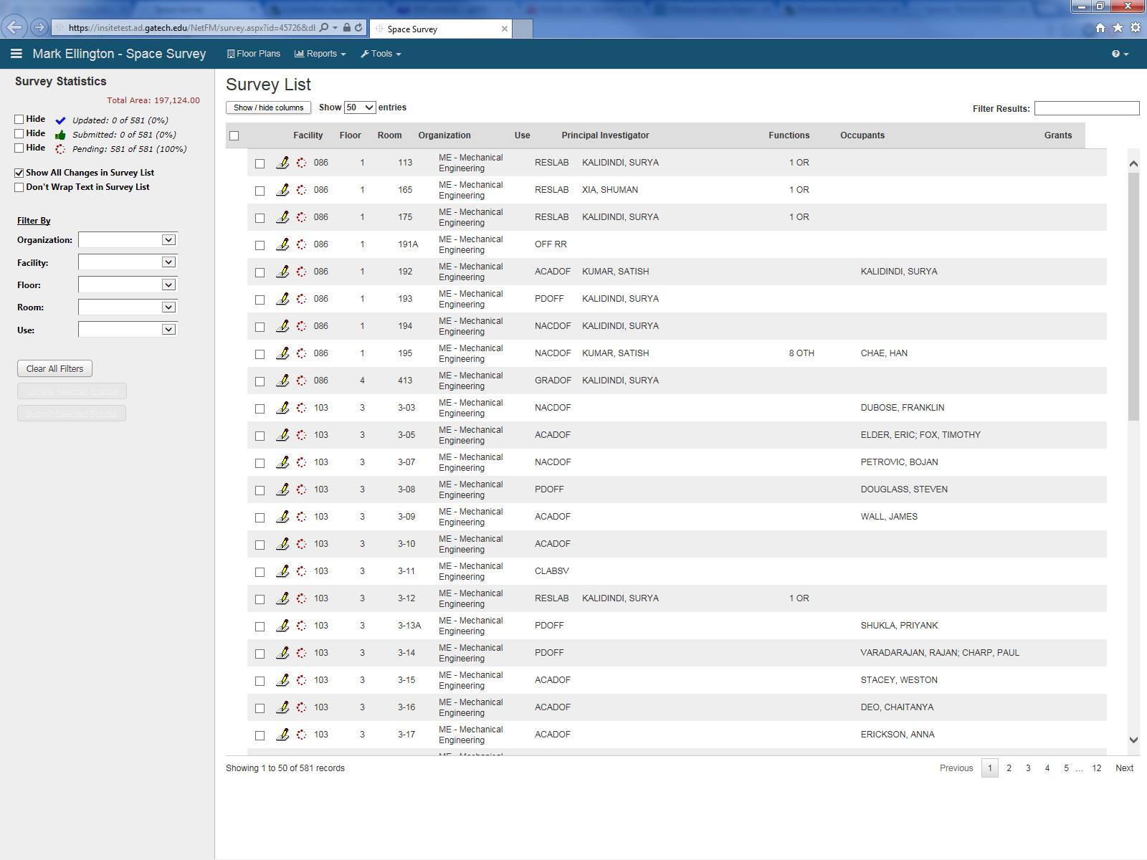
Survey List
Create Excel spreadsheet of survey list
Send email to survey administrators
Click to expand main display
Floor plans
Quick filter
Record counts
Survey list filters
Click pencil icon to review and update room for the space survey
Use checkboxes to update multiple rooms at a time with the same data

Slide 32
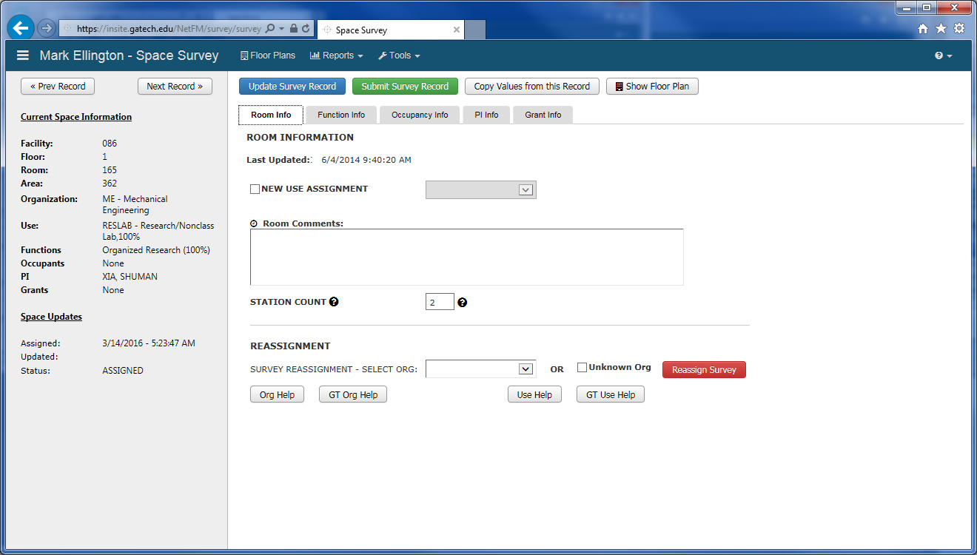
Individual Room Display
Click on name (or select under Tools) to return to Survey List
Move to next or previous room. Use these AFTER saving any changes for the current room
Click to save, but NOT submit space (You still want to review or make additional changes later)
Click to save AND submit space; then moves to next room
(This means you are finished updating this space)
NOTE: You can still update rooms even after you have submitted them
Click to expand main display
Click to view floor plan with this room highlighted in blue. * NOTE – If the floor plan has changed, contact John Holcombe for assistance.
Tabs for different groups of information regarding this room
Original values
“GT” Help buttons

Slide 33
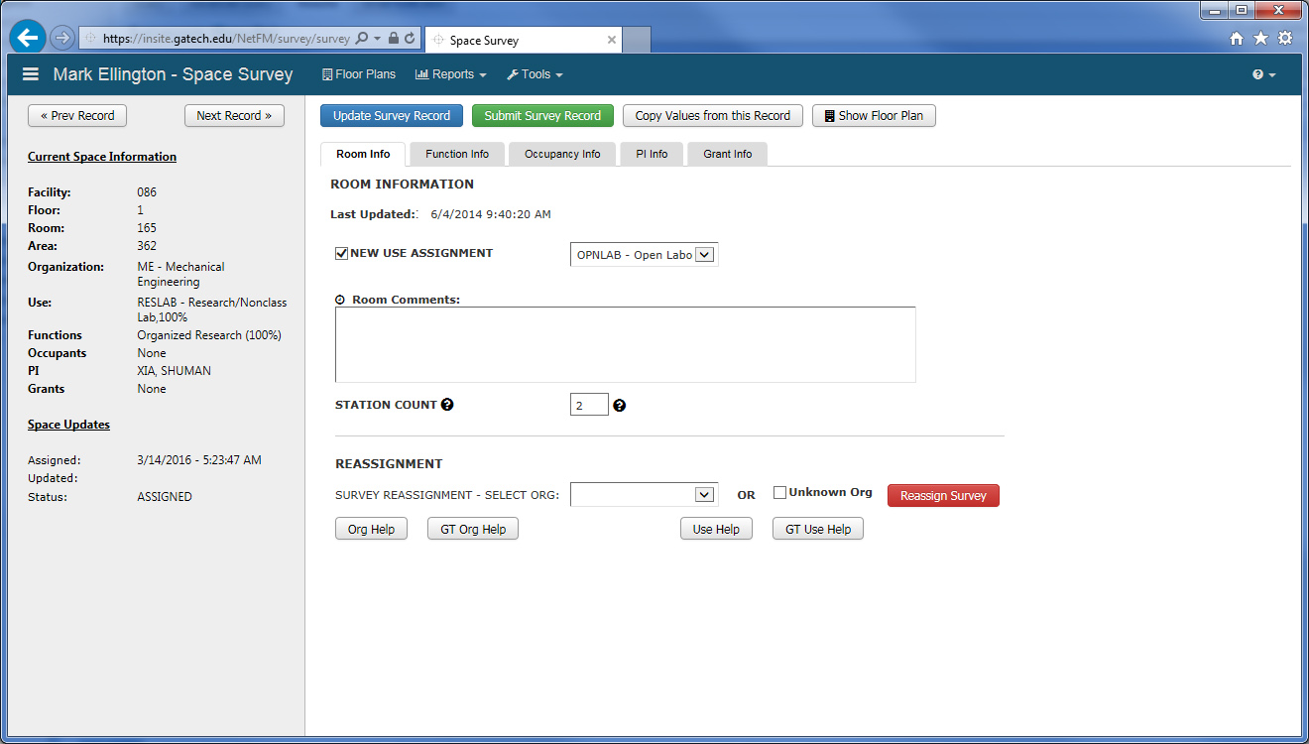
Individual Room Display
Room Info Tab
Confirm Room number and organization assignment
Click “New Use Assignment” Box and select from Use List to change room type
Use “Room Comments” to clarify room type or to indicate situations such as vacant spaces under renovation.
Enter seat or workstation count for classrooms, conference rooms, labs, offices, etc.
If room does not belong to your organization, indicate here and click
“Reassign Survey Record”

Slide 34
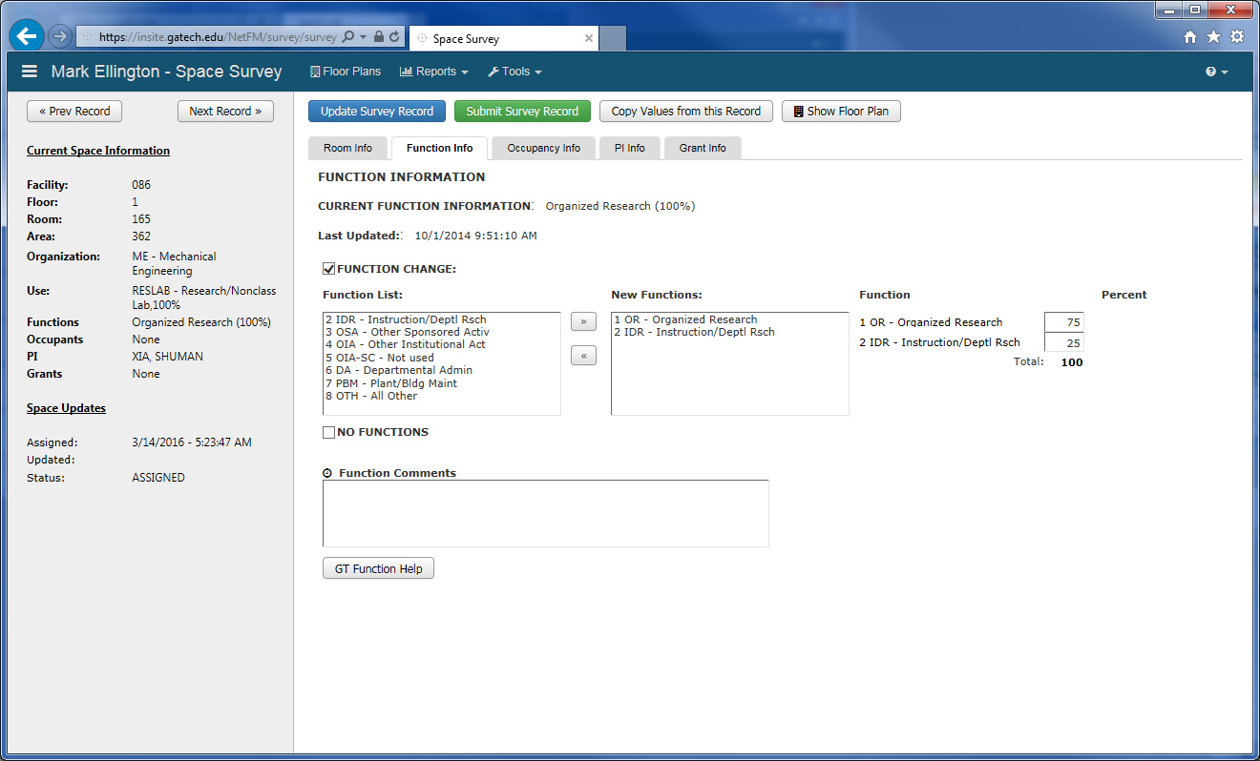
Individual Room Display
Function Info Tab
Click “Function Change” Box, select from Function List, and click >> or << to add or remove room function(s) – Update percentages as needed
* NOTE – Function comments required for all rooms functionalized as “OTH”
* NOTE – Function(s) required for all lab and lab service rooms

Slide 35
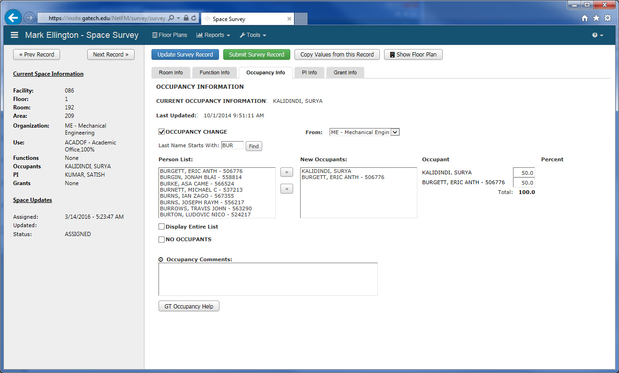
Individual Room Display
Occupancy Info Tab
Click “Occupancy Change” Box, select from Person List, and click >> or << buttons to add or remove occupant names(s) – Update percentages as needed
GT Department specification for occupant
* NOTE – If you can’t find the occupant in the person list, specify details here
* NOTE – Occupant name(s) required for all Faculty, Staff, & Post-doc Offices

Slide 36
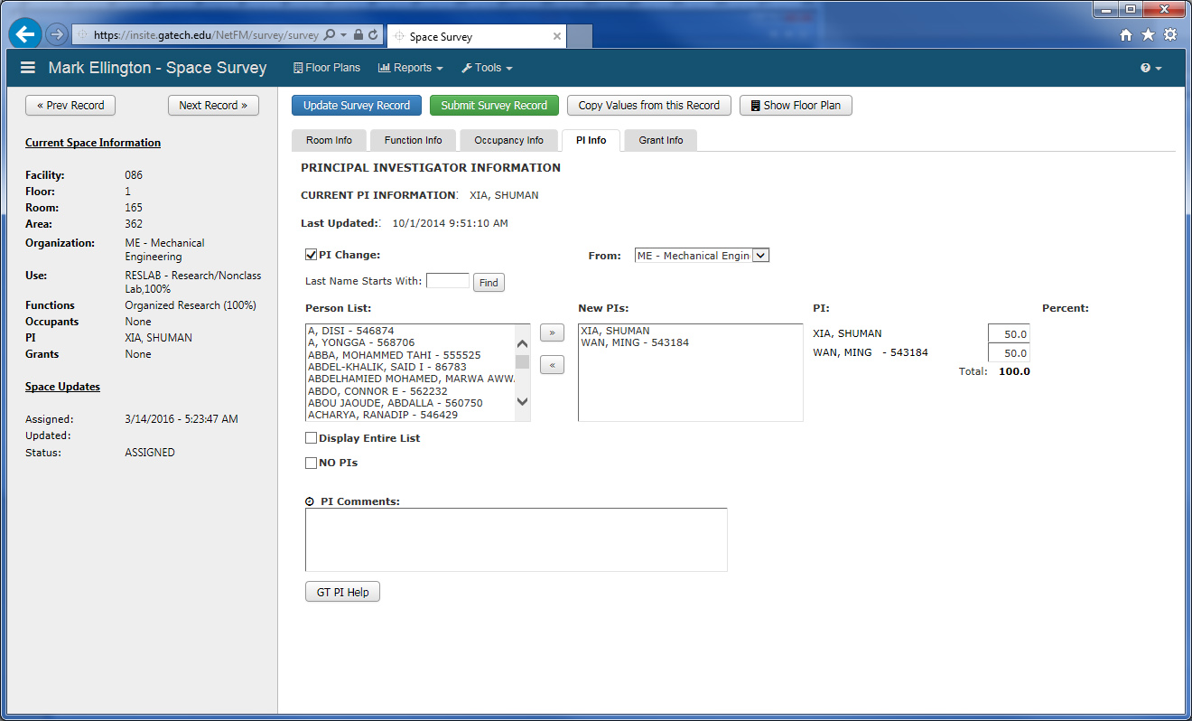
Individual Room Display
PI Info Tab
Click “PI Change” Box, select from Person List, and click >> or << buttons to add or remove PI names(s)
GT Department specification for PI
* NOTE – If you can’t find the PI in the person list, specify details here
* NOTE – PI Name(s) required for all labs and lab service rooms

Slide 37
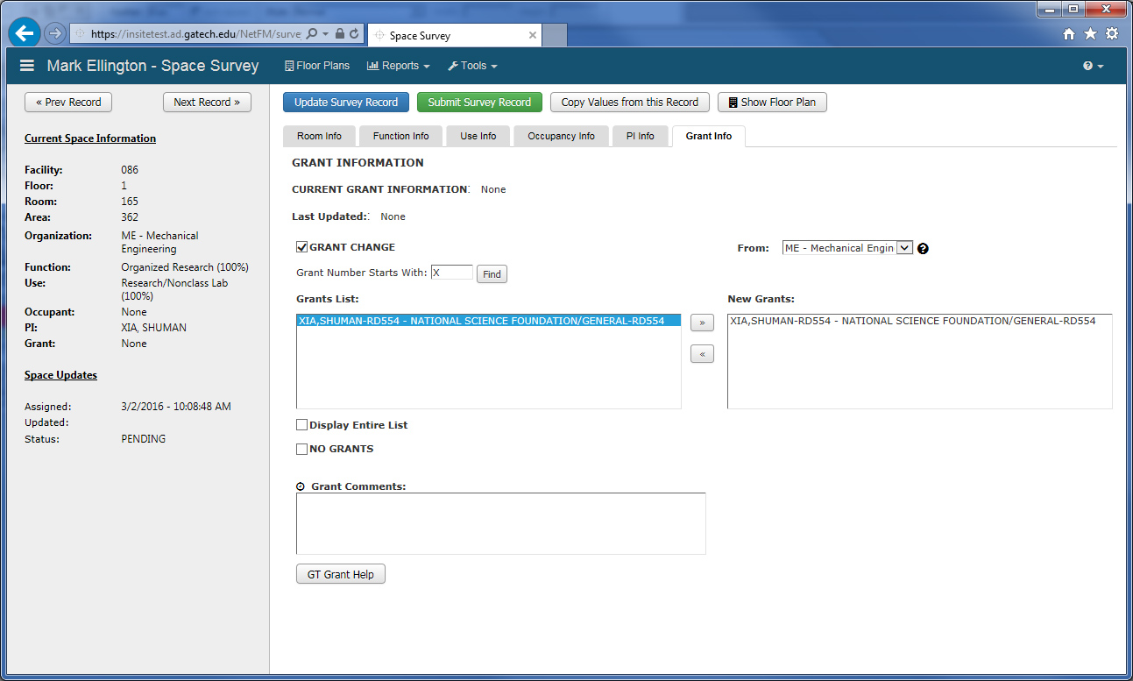
Individual Room Display
Grant Info Tab
Click “Grant Change” Box, select from Grants List, and click >> or >> buttons to add or remove grant(s)
GT department specification for grant
* NOTE – Grants are listed by employee name
* NOTE – Grant(s) required for any lab or lab service rooms functionalized as Organized Research

Slide 38
After making changes to a room
Update or Submit?
Click on name (or select under Tools) to return to Survey List AFTER saving any changes
Click to save, but NOT submit space (You still want to review or make additional changes later)
Click to save AND submit space; then moves to next room
(This means you are finished updating this space)
NOTE: You can still update rooms even after you have submitted them
Move to next or previous room. Use these AFTER saving any changes for the current room

Slide 39
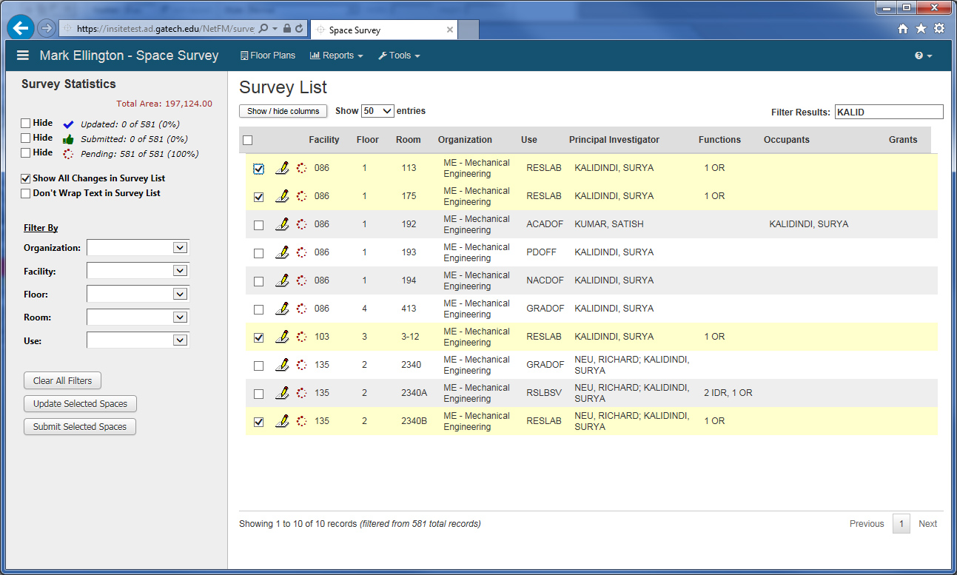
Advanced Usage - Multiple Room Update
Select Rooms to Update
First, use any combination of filters to reduce list, then select all rooms needing the same updates
Then click “Update Selected Spaces”

Slide 40
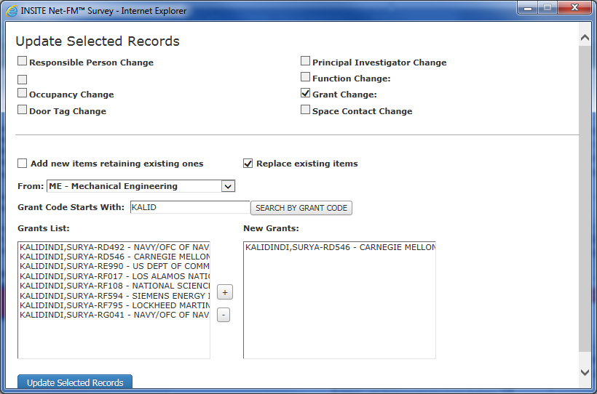
Advanced Usage - Multiple Room Update
Specify Fields to Update for the Selected Rooms
Select items to change
Use Change
Then complete fields as appropriate and when finished, click “Update Selected Records”

Slide 41
More Advanced Usage
Copy Values from this Record…

Slide 42
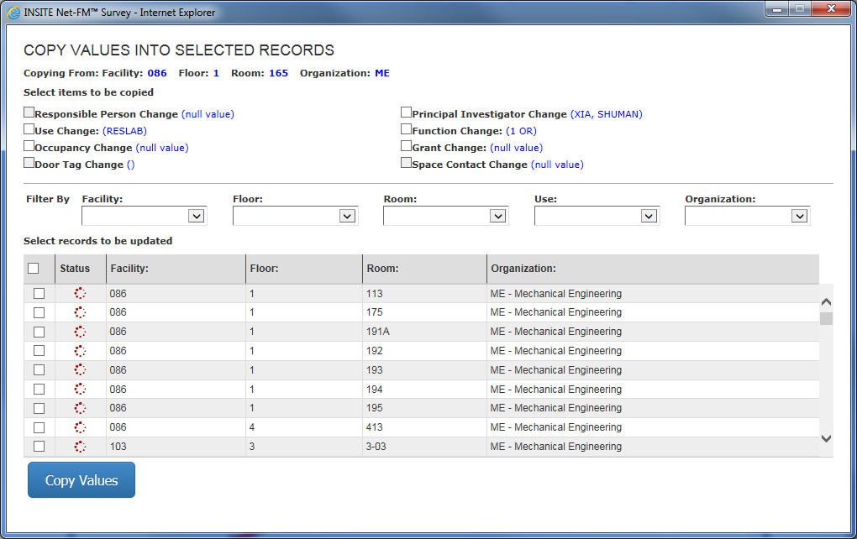
More Advanced Usage
Copy values into selected rooms
Select items to copy
Use filters to narrow list of rooms
Use check boxes to select rooms to receive copied items
Click “Copy Values” when ready

Slide 43
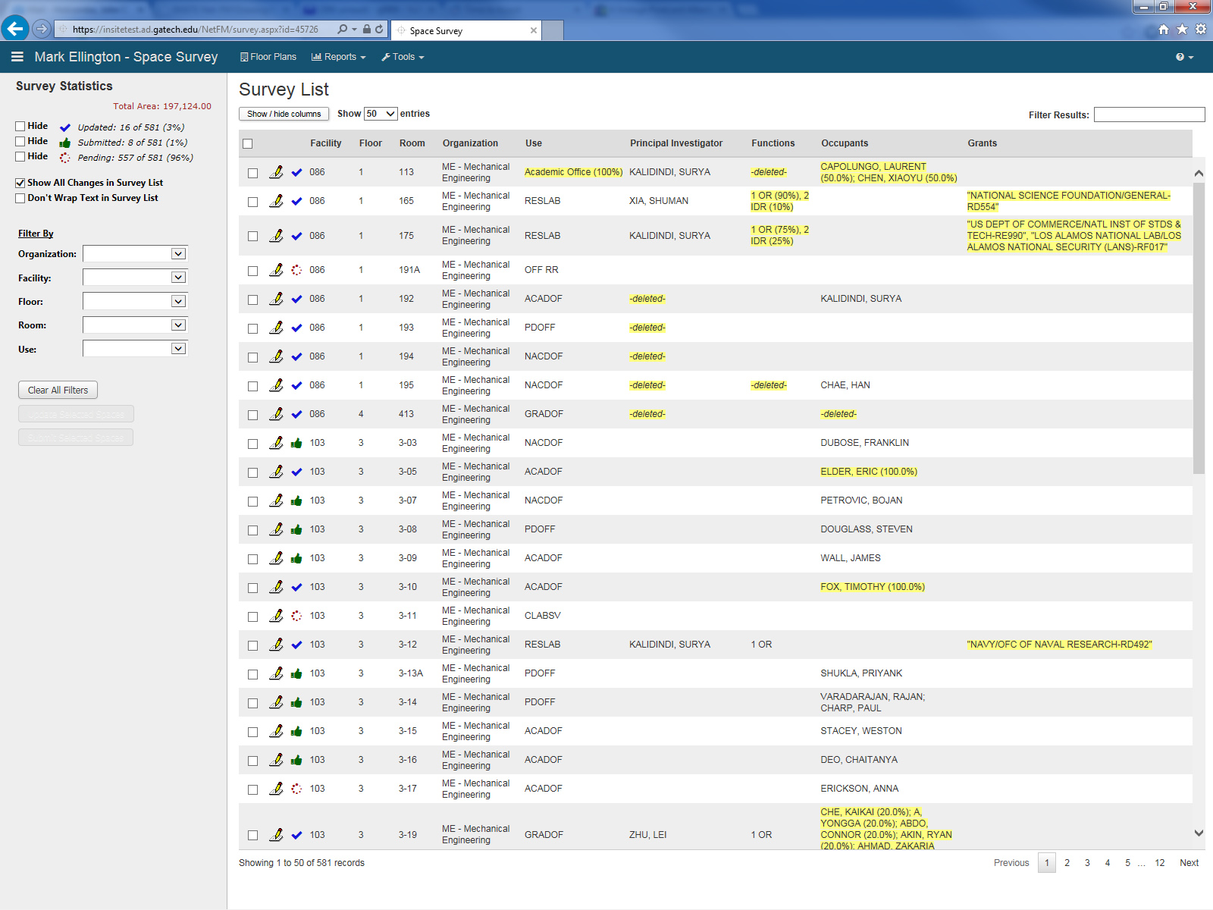
Survey List
After updating spaces
Record counts
Blue “check mark” icon indicates updates have been made, but not submitted
Changes highlighted in yellow
Green “thumbs up” icon indicates record has been submitted

Slide 44
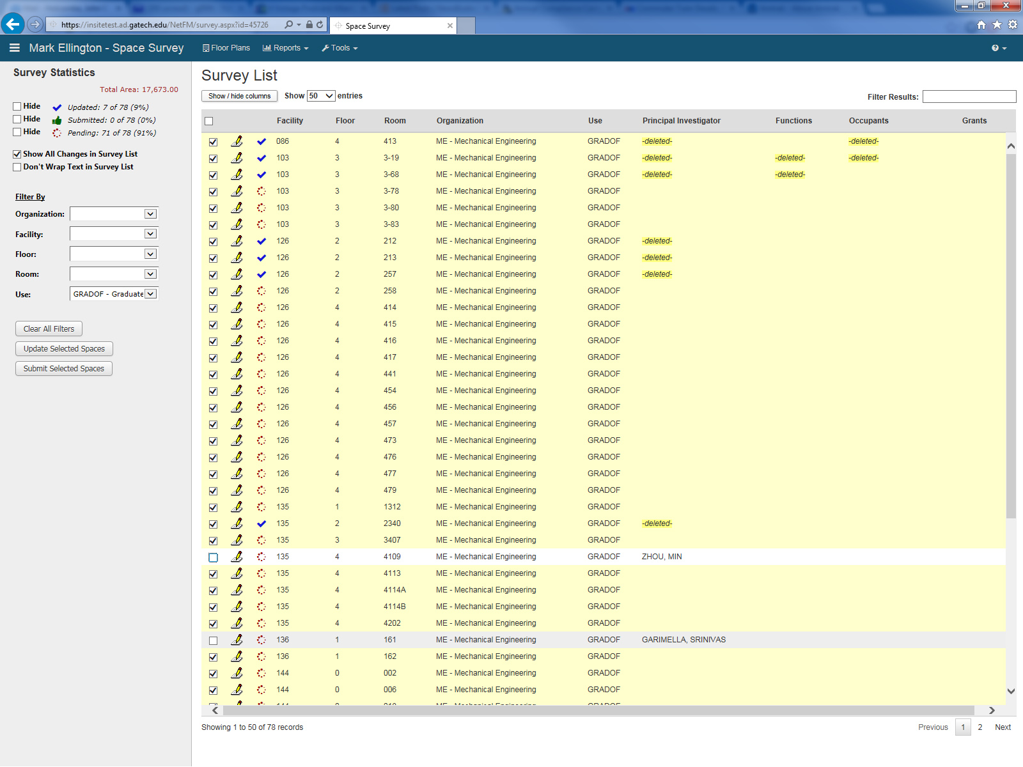
Survey List
Submitting Multiple Spaces
Use checkboxes and filters as needed to display records that you are ready to submit
Click checkboxes to select spaces to submit
Click here after selecting spaces to submit…

Slide 45
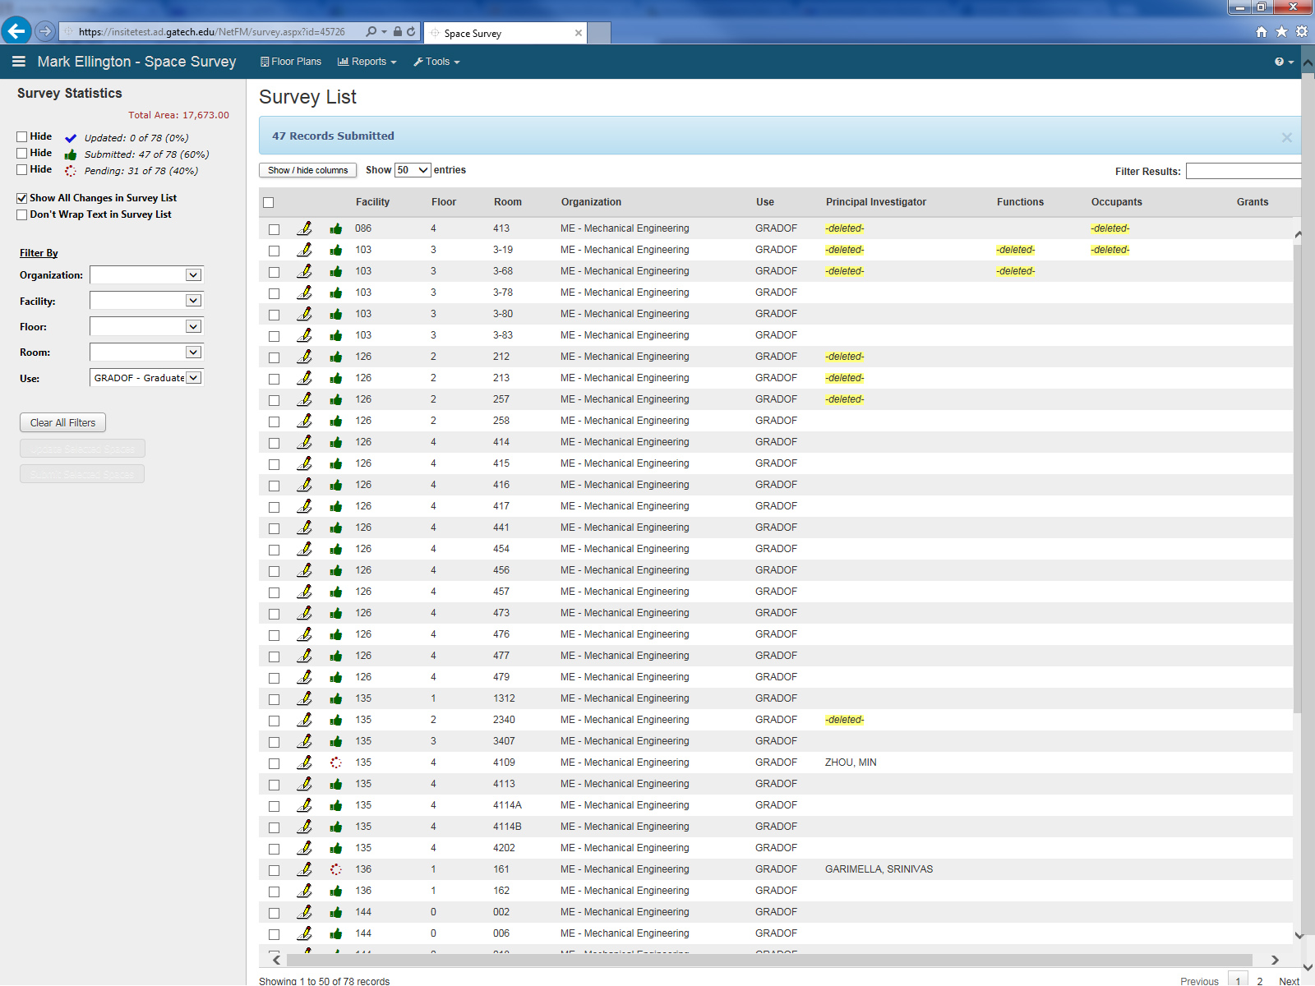
Survey List
After Submitting Multiple Spaces
New Submitted count
Green “thumbs up” icons mean room updates are complete and have been submitted.

Slide 46
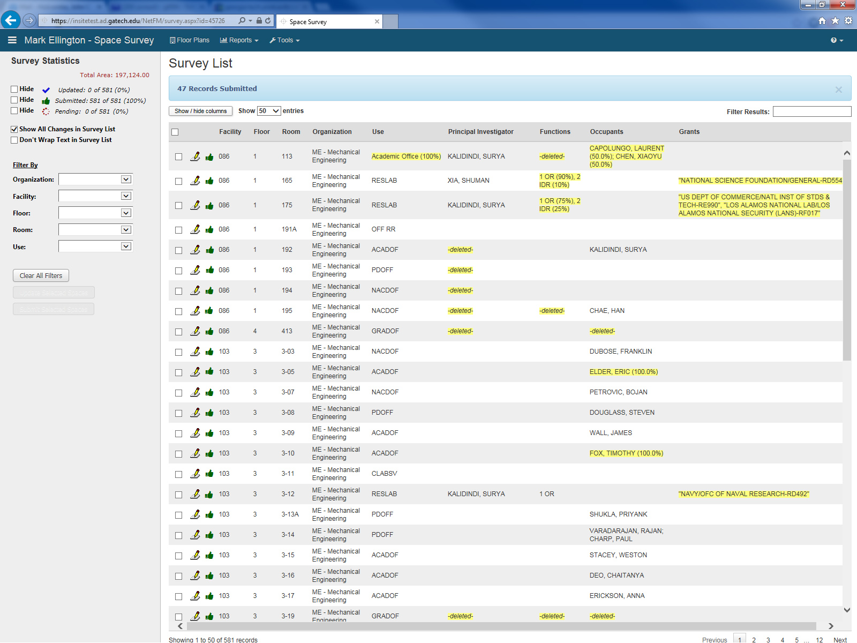
Survey List
Goal – All Rooms Submitted
All rooms are submitted!
You are done.
Green “thumbs up” icons mean room updates are complete and have been submitted.

Slide 47
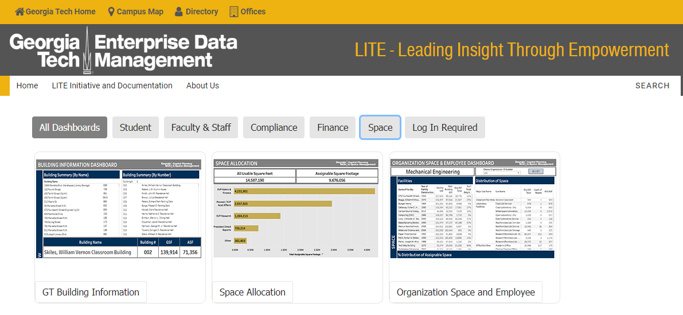
Why is this data important?

Slide 48
Questions?
Key Contact
Floor Plans John Holcombe /
Room Numbers Svetlana Soroka
Room Organization Assignment
Function Definitions Christina Phillips
Space Survey Requirements
Funding of research Unit Financial Officer
performed in Lab
Slides posted at grants.gatech.edu >Policies and Procedures>
Manuals and Notices> G&C Manuals

